Slide 1
Benford’s Law: The law of first digits

Slide 2
What is it?
”In a naturally occurring set of numbers, the smaller digits appear disproportionately more often as the leading digits”

Slide 3
Uses?
Cybersecurity
Fraud Detection
DoS Attacks
Notes:
Current cybersecurity systems rely heavily on identifying anomalous behaviors. Looking only for known signatures does not address the breadth of the threat landscape--unknown signatures are equally important. Anomaly detection is generally hard to establish because creating a baseline traffic profile and processing the large amount of traffic data are time-consuming processes.
Benford's law can help avoid the effort of baseline-derived anomaly detection. If the network traffic conforms to the assumptions of Benford's law, any traffic data deviating from the Benford curve can be considered an anomaly. Benford's law performs much of the legwork, rather than manual computation.
DOES NOT APPLY FOR: ID numbers,
phone numbers
zip codes.

Slide 4
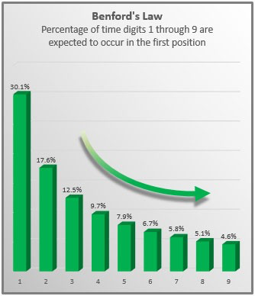
Number Frequencies

Slide 5
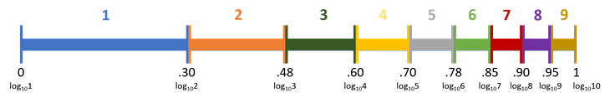
Underlying Math
log10(1+1/d)
Notes:
The size of the number doesn't matter. Whether you're dealing with five-digit or two-digit numbers, the probability of a given leading digit can be predicted for data fitting Benford assumptions by looking at the first two decimals of the base-10 log of the number.

